Slide 1
2025-2026
Pre-K Program Enrollment

Slide 2
Pre-Kindergarten Programs
Pre-kindergarten programs are grant funded programs that were established to capture our most “at risk” students and prepare them to successfully enter kindergarten.
Non-paying “free” seat: Students must meet age, income, residency, and immunization requirements. Those families not meeting income eligibility may still receive a “free” seat based upon qualifying parent responses from the health and development section of the application.
Tuition seat: Students not meeting the income program requirements and have no health and development risk factors may be offered a tuition seat based on availability at the selected school site.

Slide 3
Early Childhood Enrollment Application
IMPORTANT: When creating the guardian account, the guardian on the account MUST be the parent or guardian listed on the birth certificate or custody documentation. DO NOT SET UP AN ACCOUNT in someone else’s name or you will have to start over with a new account listed as the parent or legal guardian for the child!!!!! Photo ID will be required!
https://vermilionearlychildhood.schoolmint.com/

Slide 4
What documents do you need to successfully register your child for PreK?
TIP: all documents must be clear and show the FULL document. Illegible copies will not be accepted.
01
02
03
04
05
Child Information
Household Information
Health and Development
(2) Proof of Residency
Proof of
Income
Birth Certificate
Social Security Card
(If applicable)
Guardian(s) Photo ID
Legal Custody or Foster documents
Current Immunization record
If expired, must have appointment card for missing shots.
First proof must be the electric bill
Each adult, age 18 and older, living in the household must provide proof

Slide 5
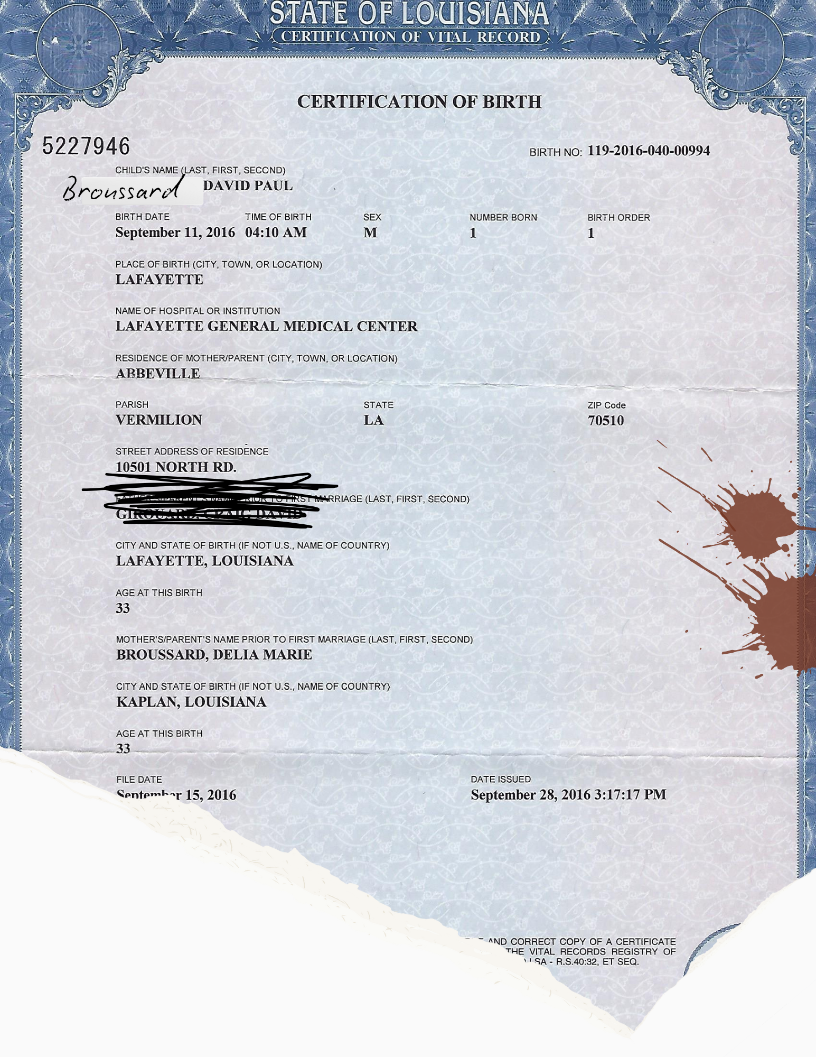
Child’s Birth Certificate
Unacceptable
01
Your child must be 4 years old on or before September 30, 2025.
Applications for replacement birth certificate, hospital footprint certificate, or birth certificates with markings, white out, or crossed out information will not be accepted.
Uploaded document must be a clear copy of the full birth certificate.

Slide 6
Child’s Social Security Card
01
The social security card must match the child being registered for PreK. The card is matched to the birth certificate.
If the card is not available, the social security number is needed to proceed with registration. If the number is provided, a copy of the card can be submitted at a later date.

Slide 7
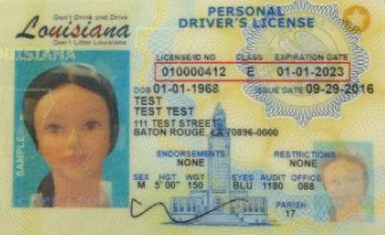
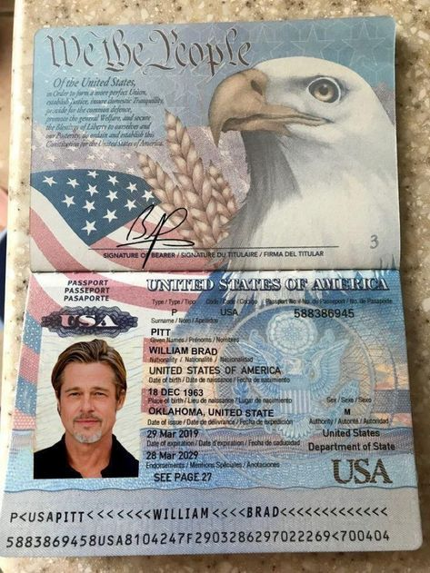
Guardian Photo ID
02
Uploaded document must be a clear copy.
If the parent’s full name does not match the name on the birth certificate, further verification documents may be required such as a marriage license, death certificate, or divorce decree.

Slide 8
Child’s Current Shot Record
03
The immunization record must match the child being registered for PreK. The record is verified by matching the information to the birth certificate.
The immunization record must be current as indicated by the expiration date at the top of the record.
If the record is expired, the official appointment card for the missing shots from the pediatrician will be required along with the expired record.
If a parent does not want immunizations, the parent will need to indicate this on the application to complete the Immunization Waiver in the application.

Slide 9
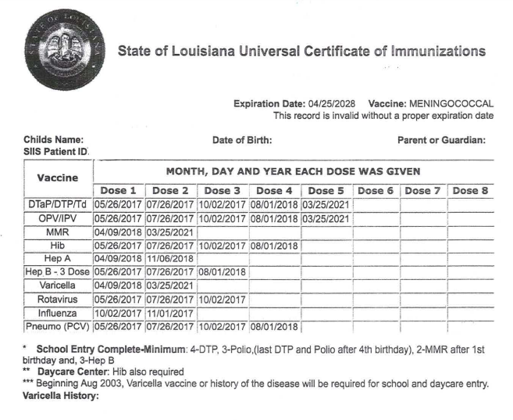
Current Shot Record Example
TIP: If your child’s record does not look like this example, it can delay processing of the application because further verification is required.

Slide 10
First Proof of Residency is the Electric bill
04
The parents MUST provide a current electric bill for an active account at their current residence as the first proof of residency. An electric bill with a DISCONNECT NOTICE will not be accepted.
All residency documents must be listed as the parent’s name on the birth certificate. Further documentation is required for parents whose name has changed to connect the new last name on the bill to the original name listed on the birth certificate. Examples include: marriage certificate, divorce decree, death certificate.
If the electric bill is listed as one of the parent’s on the birth certificate, but that parent is not living in the household, residency documentation for the parent not living in the household must also be provided to verify household count.
TIP- ONLY a current and valid electric bill is accepted as the first proof of residency. If you submit any other document, the processing of your application will be delayed.

Slide 11
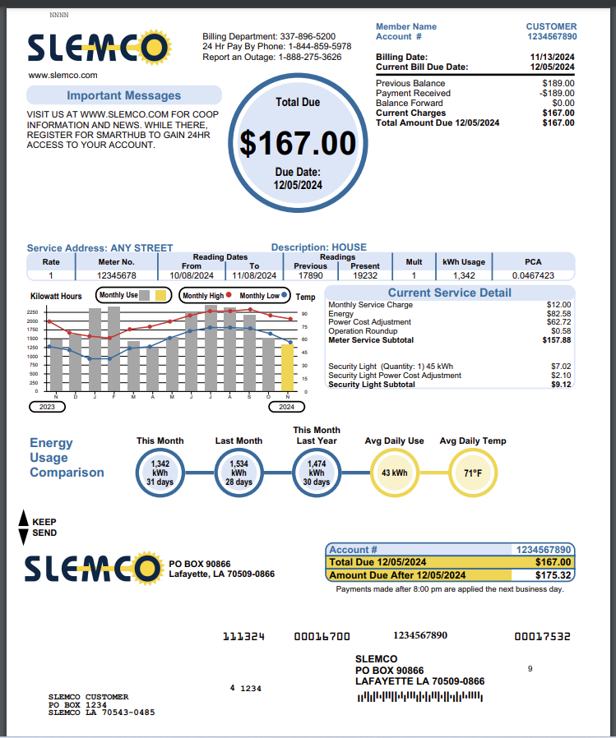
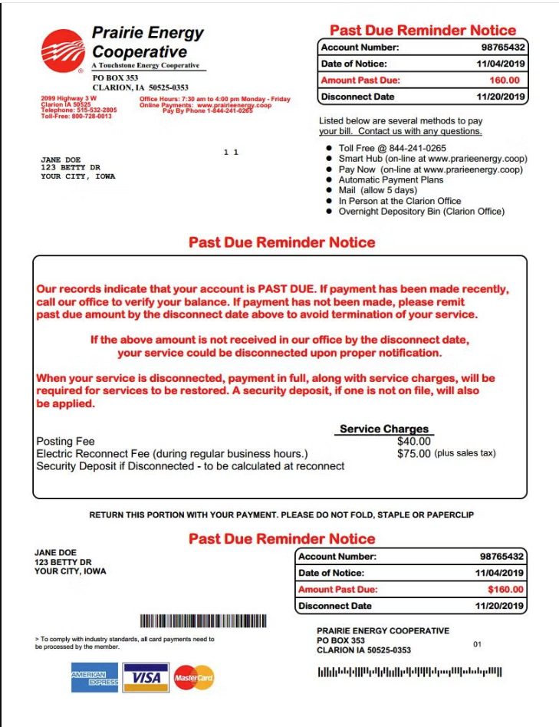
First Proof of Residency is the Electric bill
04
Acceptable
Unacceptable

Slide 12
Second Proof of Residency
04
If a family resides with someone else, the Vermilion Parish Affidavit of Student Residency must be completed, signed, and notarized. The information provided on the affidavit must match the person’s name on the electric bill. This will become the second proof of residency. See next two slides for more information!
If the electric bill is in the parent’s name on the birth certificate, one of the following must be submitted as the second proof of residency AND must be listed in the name of the parent/guardian who resides in the home:
Utility bill: water, sewage, or gas bill
Full lease agreement including terms and signature pages
Current mortgage statement
Ownership documents: cash sale, deed, filed Homestead Exemption or current property tax statement

Slide 13
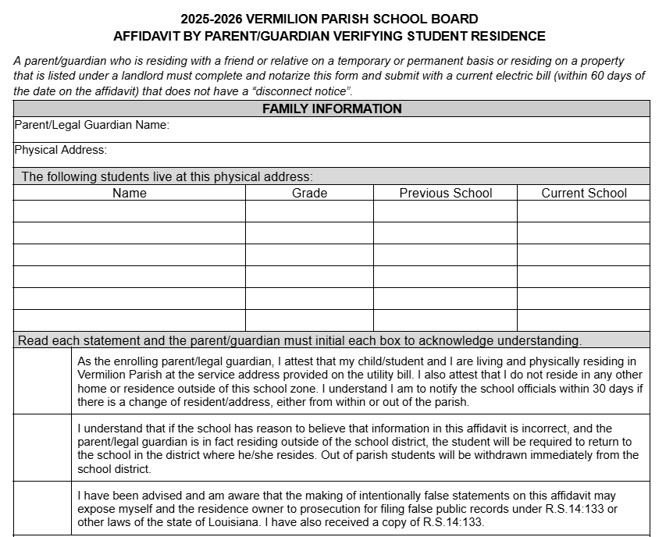
Second Proof of Residency- The Notarized Residency Affidavit
04
TIP: Make a copy to keep for your records and to drop off to the school for any other children living in the home. The ORIGINAL document MUST be submitted to the Early Childhood Office before you can be offered a seat in the program.
The parent must read and initial to verify understanding of these statements.

Slide 14
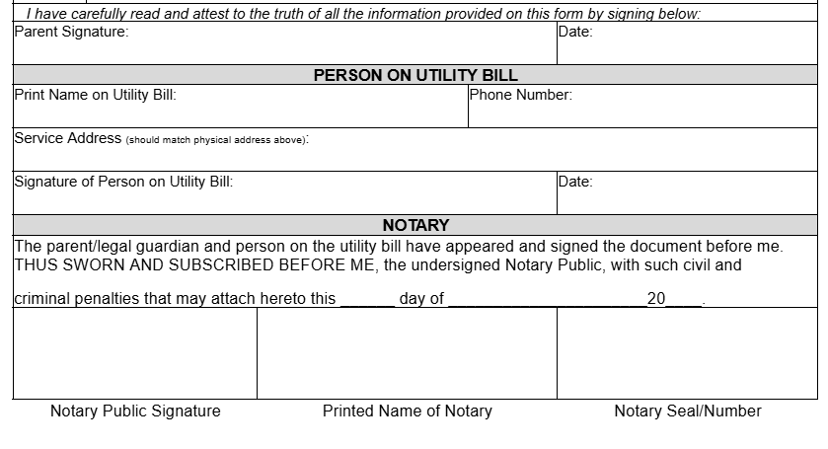
The Notarized Residency Affidavit cont.
04
Name and address on the electric bill should match this section of the affidavit. The person on the utility bill must be present to sign in front of the notary.
The date the Notary signs must match date of parent signature!
Not valid without Notary signature and seal/number!!!

Slide 15
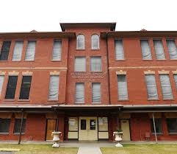
The Notarized Residency Affidavit cont.
04
Complete Vermilion Parish Affidavit of Student Residency. Be sure to complete all sections and document is notarized!
Original affidavit must be brought to the Vermilion Parish School Board. Located at: 220 South Jefferson Street, Abbeville, LA 70510
Affidavit must be placed in our drop box, located on the Early Childhood door. See picture.
Parents/Guardians do not need to hand deliver. A staff member will email you to confirm receipt.

Slide 16
Proof of Income
05
If the child currently receives SNAP benefits then no further documentation is needed. You will upload screenshots of the SNAP details page listing the child’s benefits and the benefits of ALL other household members. You can also submit your award letter listing the benefit amount and members of the household.
If the child does not receive SNAP, each parent or caregiver in the household will need to submit 2 consecutive check stubs for the current year within 2 months from the date of filling out the application. The rate of pay must be the same on both check stubs (monthly salary or hourly rate of pay)
If the parent/guardian does not have check stubs, the employer can provide an official letter on the company letterhead stating all of the following:
Where the parent/guardian is employed.
Hourly rate of pay
Average number of hours per week

Slide 17
Other Approved Proof of Income
05
Current foster care placement agreement from DCFS. Must be a copy of the full agreement including the signatures page and caseworker contact information.
Parents/guardians who claim zero income of any kind must each submit a Statement of No Income form.
Families in a temporary living arrangement due to loss of housing or homelessness should have their status verified through VPSB Student Services: 337-898-5708 or 337-898-5760. Proper documentation will be submitted on your behalf from Student Services.

Slide 18
Other Approved Proof of Income
05
Parents/guardians who are employed intermittently, self-employed, or who do not have tax forms or check stubs must submit a Declaration of Income for Irregular Employment form.
All blanks must be completed! (Except Approving Authority/Date)
The table to list gross income for the past 12 months from the application date must be completely filled out.
If current month is March 2025, then the previous 12 months starts at March of 2024 (previous year) through February 2025 (current year)
The date should include the month and year
Any months without any income should be listed as $0.00
If a person’s name is listed as paying rent/house payment, utilities, food for the child’s parent, additional financial documents may be required.

Slide 19
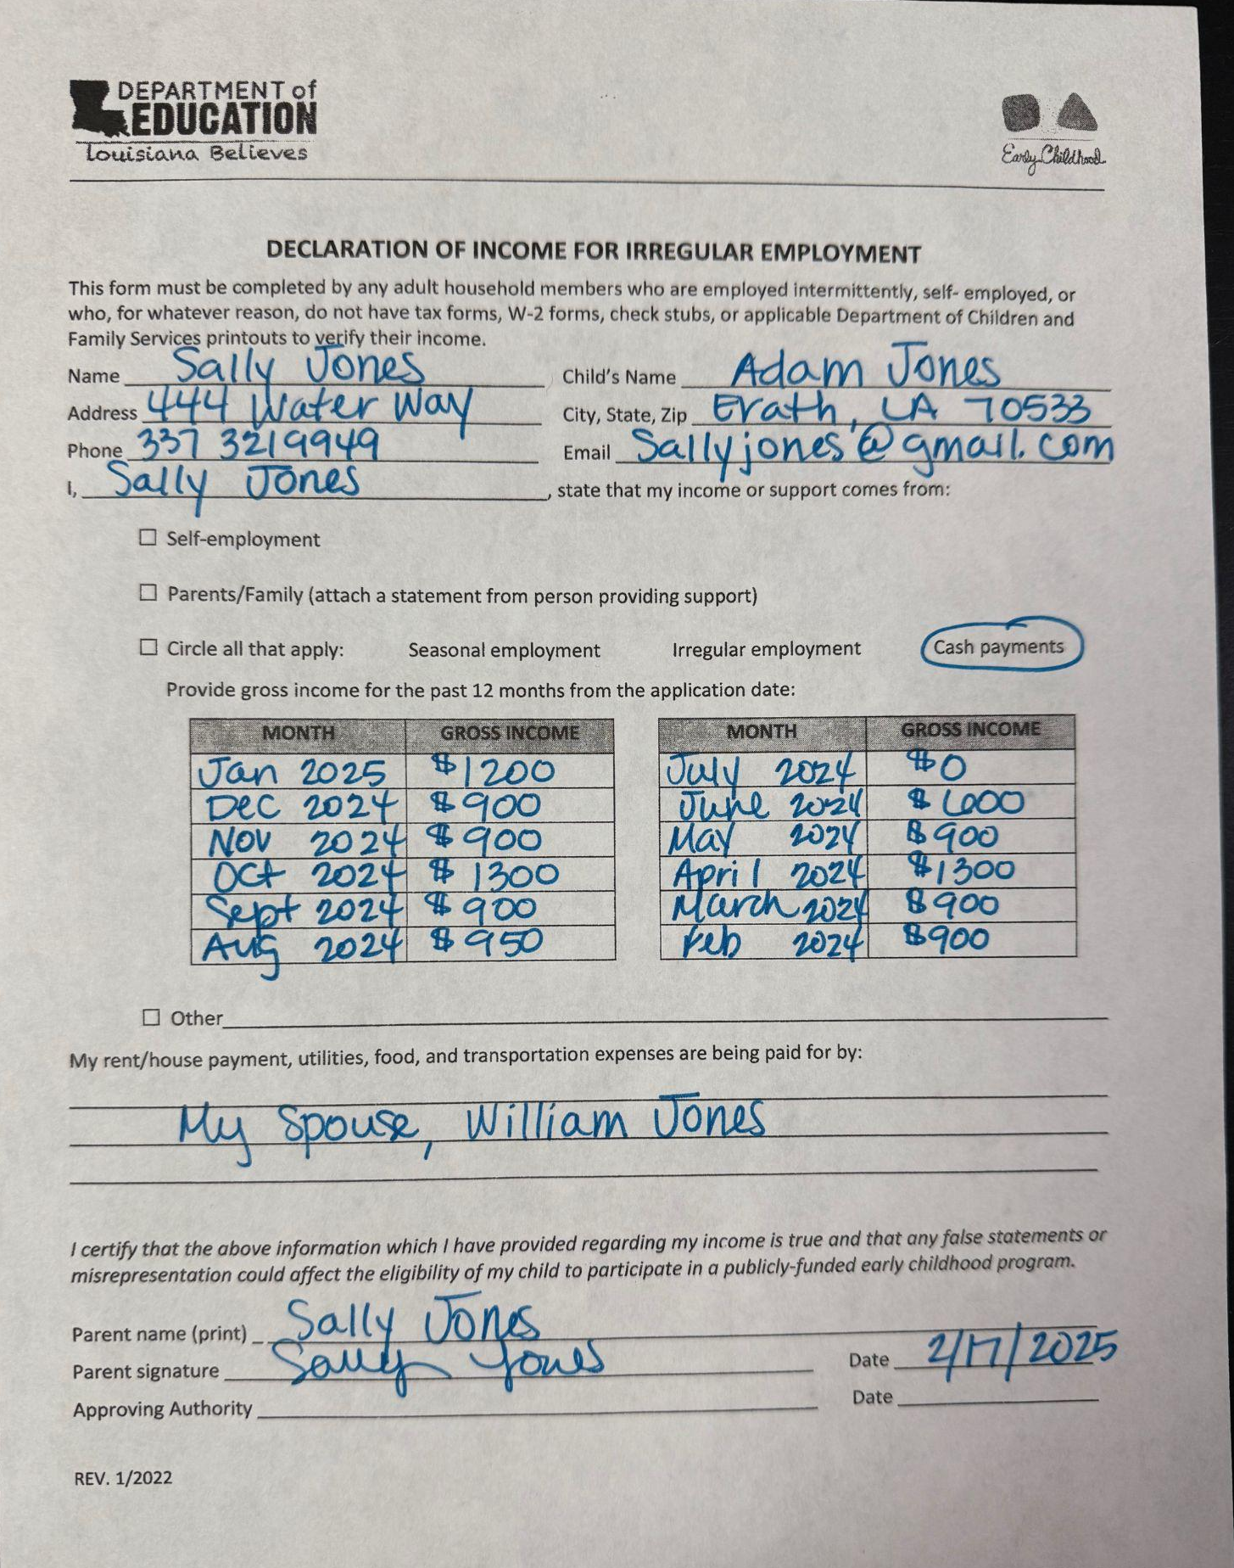
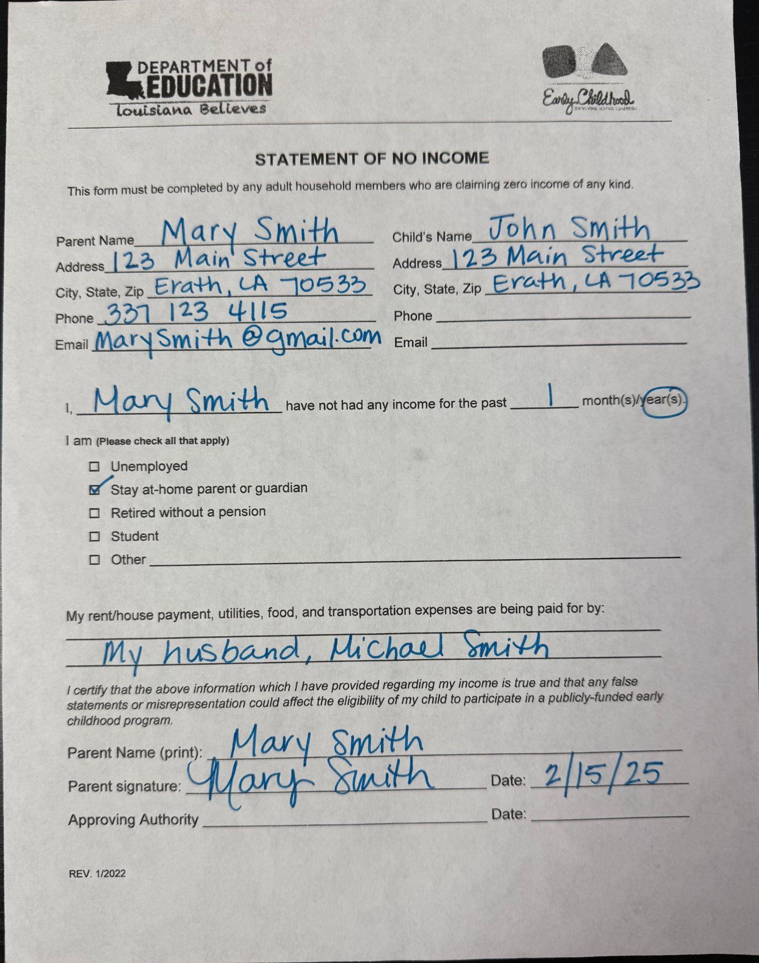
Other Approved Proof of Income
05
Declaration of Irregular Income
Statement of No Income

Slide 20
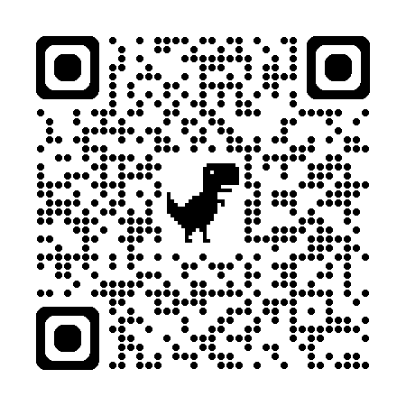
Need Forms?
vermilionchildhoodnetwork.com/publicschoolprekprogram

Slide 21
Information on PreK Tuition Charges
Tuition eligibility is based on socio-economic status and will be determined by the LA4 Program eligibility criteria.
Tuition student placement will be based on parent responses on the Health and Development portion of the application.
Monthly tuition payments will only be accepted by bank draft. Default payments can result in removal from the program.

Slide 22
PreK Tuition Payment Options
Option 1:
Paid in Full
Option 2: Monthly Installment Payments
Full amount, $3250, paid in August
Money order or Cashier’s Check payable to Vermilion Parish School Board
Payments are divided into 10 installments from August to May.
10 payments of $325 per month, regardless of # of days in the month

Slide 23
Pending Application Reminders
Missing Docs
Notification
Contact
Withdrawal
Applications with missing documents will not be considered for placement until all documents are submitted, processed, and approved.
All placement notifications will be sent by email to the email address listed on the application. Email communications alleviate delays to the approval process.
We will make every attempt to answer phone calls regarding updates on the progress of your child’s application, but please know it does slow placement determinations.
If you decide prior to June 30, 2025 to withdraw your child’s application from the program please contact our department at early.learning@
vpsb.net.

Slide 24
Questions?

